Slide 1
Australia Weather Prediction
By,
V Madhava Varun,
Gangadhar Sakha
Naveen Chennaiepalem, Ganaparthy Nikhil, Bhimanathini Aravind.

Slide 2
Overview
Accurate and timely rainfall prediction can be very helpful to take effective security measures in advance regarding: ongoing construction projects, transportation activities, agricultural tasks, flight operations and flood situation, etc.
Discusses the different methods used for rainfall prediction for weather forecasting with their limitations. Various Classification algorithms have been used for prediction are discussed with their steps in detail.

Slide 3
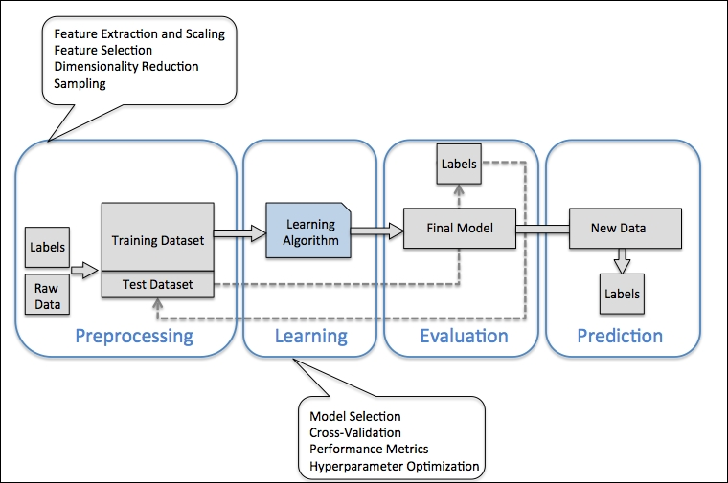
Roadmap for building Machine Learning

Slide 4
Features in the Data Set
Date
Location
MinTemp
MaxTemp
Rainfall
Evaporation
Sunshine
WindGustDir
WindGustSpeed
WindDir9am
WindDir3pm
WindDir9am

Slide 5
Features in the Data Set
WindSpeed9am
WindSpeed3pm
Humidity9am
Humidity3pm
Pressure9am
Pressure3pm
Cloud9am
Cloud3pm
Temp9am
Temp3pm
RainToday
RISK_MM
RainTomorrow

Slide 6
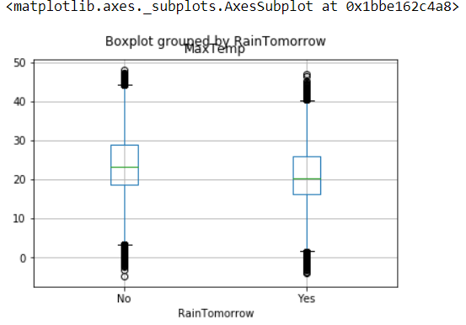
BoxPlot for MaxTemp and RainTomorrow

Slide 7
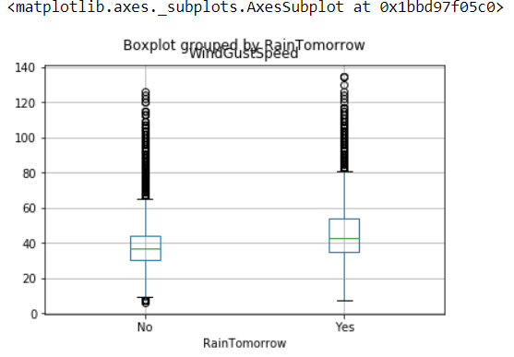
BoxPlot for WindGustSpeed and RainTomorrow

Slide 8
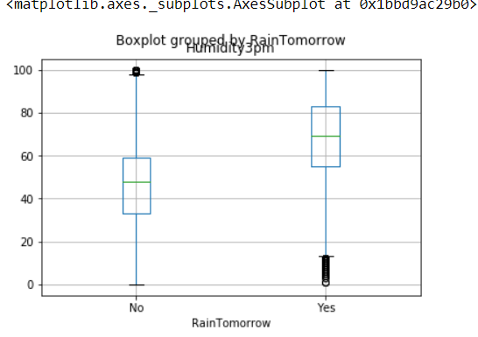
BoxPlot for Humidity3pm and RainTomorrow

Slide 9
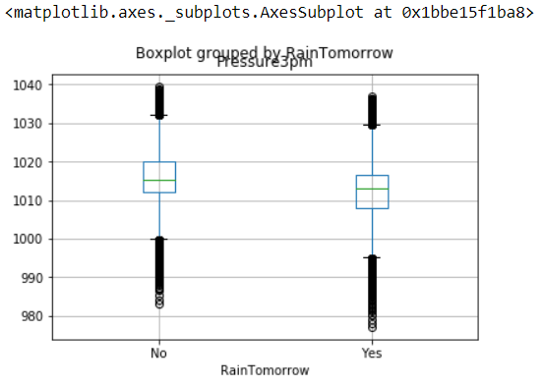
BoxPlot for Pressure3pm and RainTomorrow

Slide 10
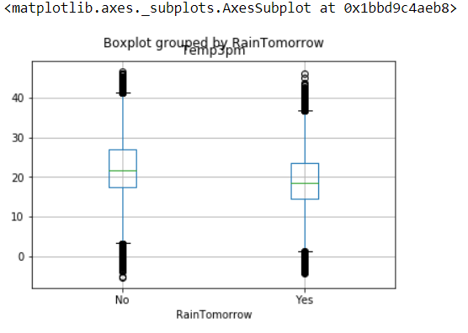
BoxPlot for Temp3pm and RainTomorrow

Slide 11
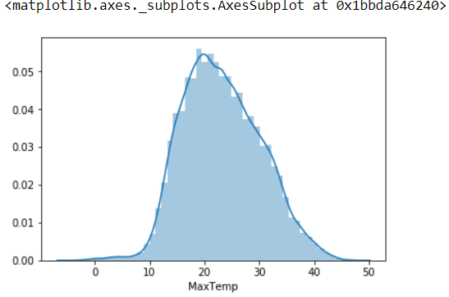
Distribution plot for MaxTemp

Slide 12
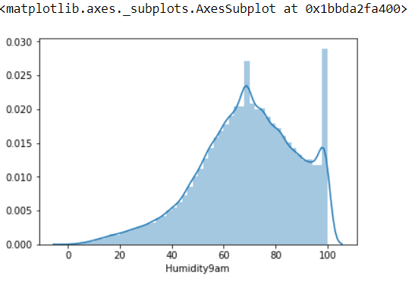
Distribution plot for Humidity 9am

Slide 13
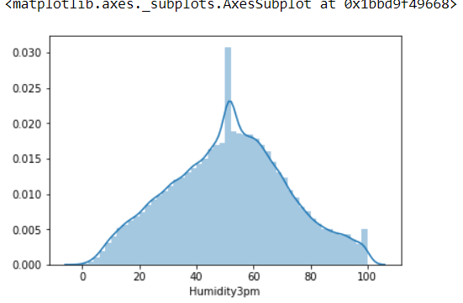
Distribution plot for Humidity 3pm

Slide 14
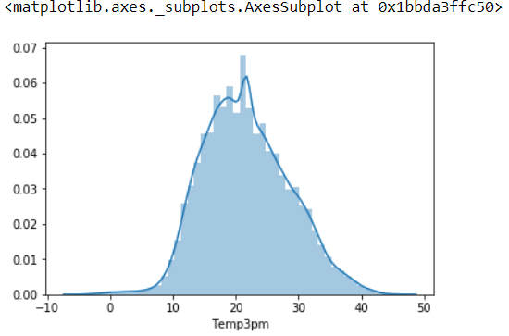
Distribution plot for Temp3pm

Slide 15
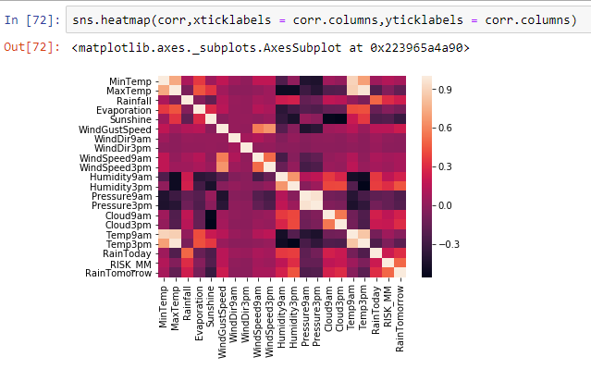
Heat Map for the Given Data Set

Slide 16
From the above analysis the factors affecting tomorrow's rain fall may be
MaxTemp
Humidity3pm
Rainfall
WindGustSpeed
Pressure3pm
Temp3pm
RainToday

Slide 17
There are many algorithms for classification in scikit learn library. The algorithms here we are going to use are…
Logistic Regression
Decision Trees
Random Forest

Slide 18
Predictors | Splitting Ratio | Model Type | Accuracy (%) |  |  | Accuracy Score | Recall Score | Roc_Auc Score | Confusion Matrix | Specificity | Sensitivity | Precision
 |  |  | Training | Validation | Testing
Humidity3pm Rainfall, RainToday | 75:25 | Logistic Regression | 82.79 | 82.76 | 82.74 | 82.50 | 39.33 | 64.41 | [[26361 1240], [4822 3126]] | 0.715 | `0.955
 |  | Decision Tree | 81.7 | 81.77 | 81.78 | 81.85 | 37.22 | 66.04 | [[26176 1425], [4986 2962]] | 0.675 | 0.839
 |  | Random Forest | 82.82 | 82.81 | 82.86 | 82.68 | 37.22 | 66.04 | [[26176 1425], [4986 2962]] | 0.675 | 0.839
RainToday Rainfall Humidity3pm | 80:20 | Logistic Regression | 82.76 | 82.73 | 82.74 | 83.06 | 39.72 | 67.55 | [[21292 853], [3981 2313]] | 0.730 | 0.842 | 0.961
 |  | Decision Tree | 81.59 | 81.65 | 81.95 | 82.23 | 37.86 | 66.35 | [[21003 1142], [3911 2383]] | 0.323 | 0.843 | 0.948
 |  | Random Forest | 82.72 | 82.78 | 82.74 | 83.00 | 36.74 | 66.44 | [[21292 853], [3981 2313]] | 0.730 | 0.842 | 0.961

Slide 19
Predictors | Splitting Ratio | Model Type | Accuracy (%) |  |  | Accuracy Score | Recall Score | Roc_Auc Score | Confusion Matrix | Specificity | Sensitivity | Precision
 |  |  | Training | Validation | Testing
MaxTemp Humidity9am Humidity3pm Temp9am Temp3pm | 80:20 | Logistic Regression | 82.19 | 82.15 | 82.28 | 82.66 | 37.05 | 66.33 | [[21176 969], [3962 2332]] | 0.706 | 0.842 | 0.956
 |  | Decision Tree | 74.02 | 74.63 | 74.14 | 74.57 | 47.34 | 64.82 | [[18228 3917], [3314 2980]] | 0.567 | 0.846 | 0.823
 |  | Random Forest | 82.37 | 82.25 | 82.54 | 82.74 | 33.47 | 65.11 | [[21426 719], [4187 2107]] | 0.745 | 0.836 | 0.967
MaxTemp Humidity3pm Rainfall WindGustSpeed Pressure3pm Temp3pm RainToday | 80:20 | Logistic Regression | 83.6 | 83.7 | 83.5 | 84.11 | 47.28 | 70.93 | [[20945 1200], [3318 976]] | 0.712 | 0.863
 |  | Decision Tree | 76.9 | 77.1 | 77.0 | 77.46 | 51.82 | 68.28 | [[18768 3377], [3032 3262]] | 0.491 | 0.860
 |  | Random Forest | 83.6 | 83.7 | 83.7 | 84.16 | 42.70 | 69.33 | [[21249 896], [3606 2688]] | 0.750 | 0.854

Slide 20
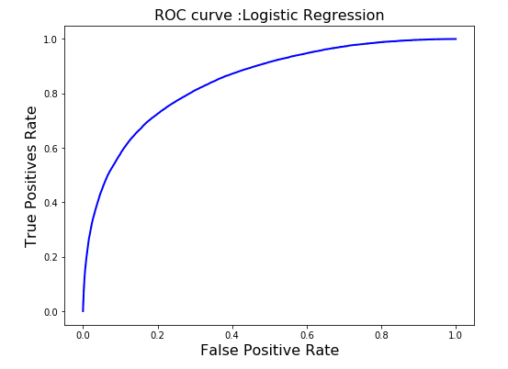
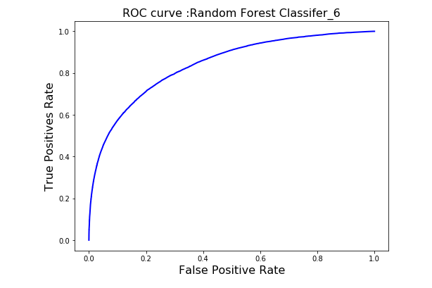
ROC CuRVES

Slide 21
Conclusion
Among all the models we have trained the Logistic Regression model and the Random Forest Classifier with maxdepth 6 have high and same accuracies but we can evaluate those two models by sensitivity, specificity, precision. But those two values are also same for two models. So we compare ROC_AUC score which is high for Logistic Regression model.

Slide 22
THANK YOU

